Slide 1

Spam Detection with Machine Learning
Réalisé par : ELASRI Hala
PROJET DE FIN D'ANNEE
Encadré par Mr BELMEKKI Abdelhamid
1

Slide 2
Table des matières
Machine Learning Algorithms
Gradient Boosting Algorithms
Build and Train the SMS Detection Model on JupyterLab
Testing the spam detection Application
2

Slide 3
01
Machine Learning Algorithms
3

Slide 4
Broadly, there are 3 types of Machine Learning Algorithms:
Supervised Learning
Unsupervised Learning
Reinforcement Learning:
Regression, Decision Tree, Random Forest, KNN, Logistic Regression
Apriori algorithm, K-means.
Markov Decision Process
4

Slide 5
List of Common Machine Learning Algorithms
Linear Regression
Logistic Regression
Decision Tree
SVM
Naive Bayes
kNN
K-Means
Random Forest
Dimensionality Reduction Algorithms
Gradient Boosting algorithms
  GBM
  XGBoost
  LightGBM
  CatBoost
5

Slide 6

02
Gradient Boosting Algorithms
6

Slide 7
LightGBM is a gradient boosting framework that uses tree based learning algorithms. It is designed to be distributed and efficient with the following advantages:
Faster training speed and higher efficiency
Better accuracy
Lower memory usage
Parallel and GPU learning supported
Capable of handling large-scale data
7

Slide 8

03
Build and Train the SMS Detection Model on JupyterLab
8
Notes:
And we are going to discover together how machine learning can help us detect spam in messages
First of all before building the test application
We need to preveiously build and train the detetction model

Slide 9
01
Exploratory Data Analysis (EDA)
02
Preprocess the Data
03
Model Building
9
Notes:
To elaborate further
We are need to go through three phases before getting the final model
The fisrt step is exploratory data analysis
Then preprocessing the data
And finally building the model

Slide 10
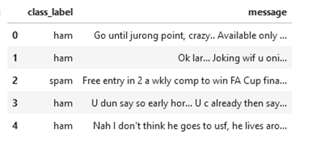
Exploratory Data Analysis (EDA)
In statistics, exploratory data analysis is an approach of analyzing data sets to summarize their main characteristics, often using statistical graphics and other data visualization methods.
We chose a dataset that contains 2 columns. Column v1 is the dataset label (“ham” or “spam”) and column v2 contains the text of the SMS message.
10
Notes:
This step allows us to analyse the data sets in order to summrize it down to what is relevant to our case
We choose a dataset that has two columns
The first one is tha labels
The second one is the message it self
irrelevant or unsolicited messages sent over the internet, typically to a large number of users, for the purposes of advertising, phishing, spreading malware, etc.

Slide 11
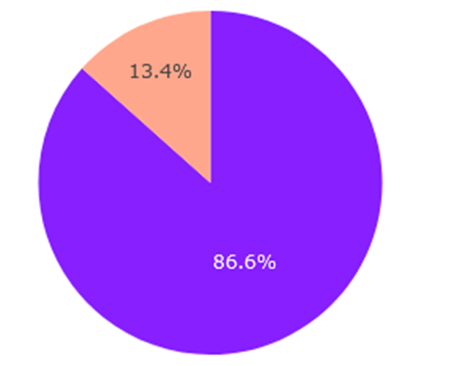
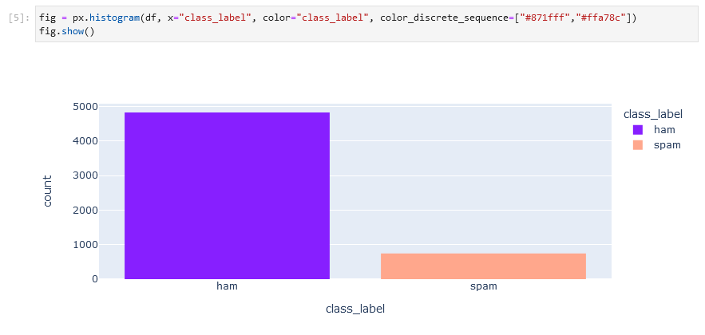
Let's look at the distribution of labels:
11

Slide 12
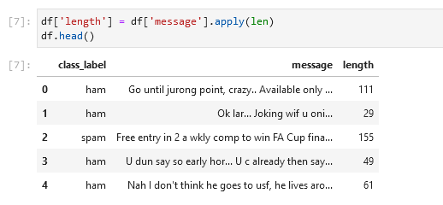
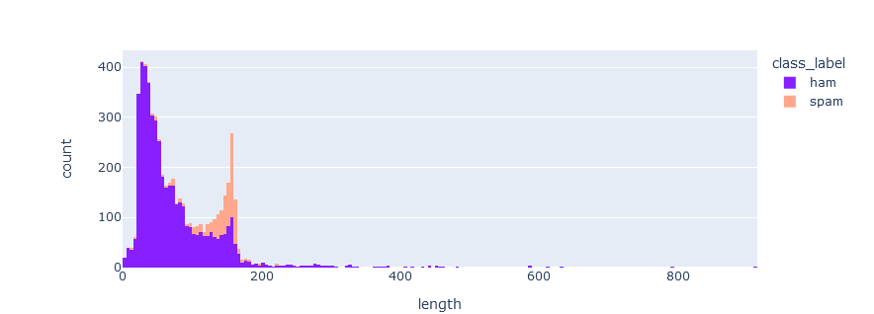
The length of the messages
12

Slide 13
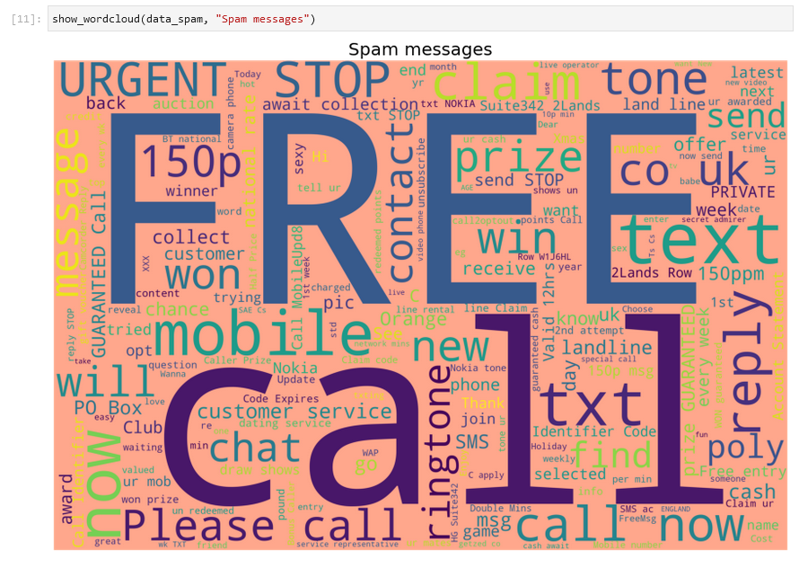
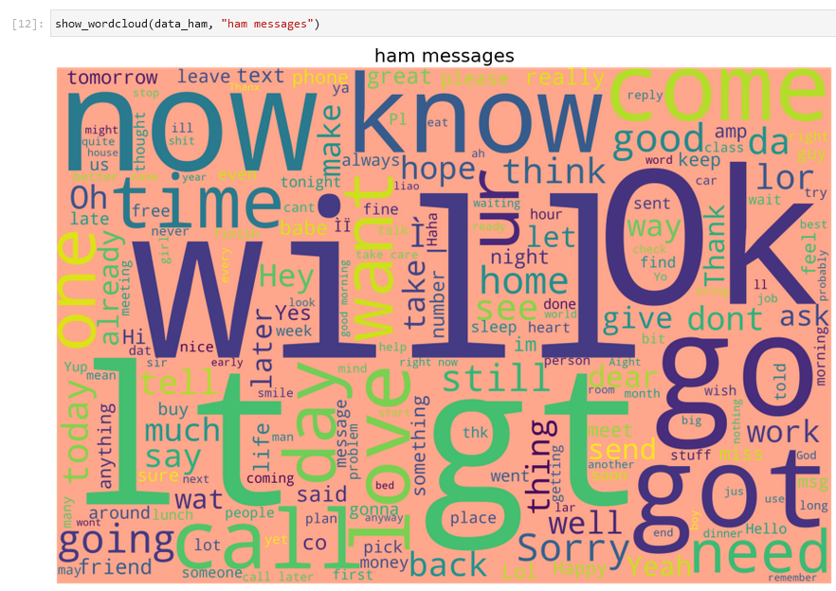
Word Cloud
Spam messages
Ham messages
13

Slide 14
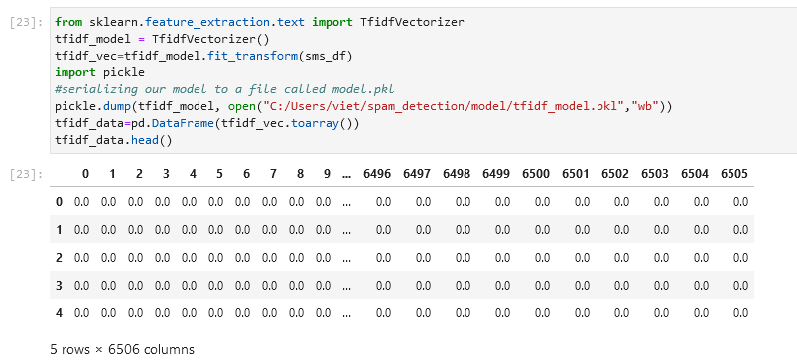
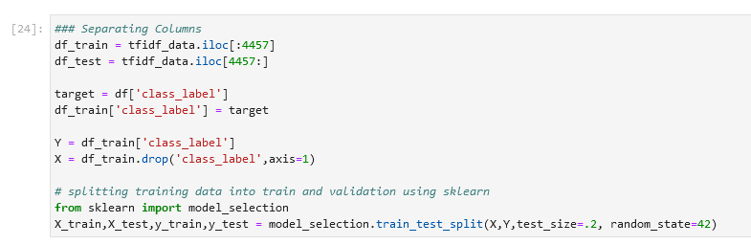
Preprocess the Data
14
In any Machine Learning process, Data Preprocessing is that step in which the data gets transformed, or Encoded, to bring it to such a state that now the machine can easily parse it. In other words, the features of the data can now be easily interpreted by the algorithm.
Notes:
In other words, the features of the data can now be easily interpreted by the algorithm.
there are several steps in this stage in modeling, they are explained in the report, i chose the Neuro-linguistic programming part of it for its importance in what comes next,
So the nlp relates thoughts, language, and patterns of behavior learned through experience to specific outcomes.
we will implement an NLP (Neuro-linguistic programming) technique to evaluate how important words are in the text data. In short, this technique simply defines what a “relevant word” is. The tfidf_model created from this NLP technique will be saved (serialized) to the local disk for transforming the test data for our web application later:

Slide 15
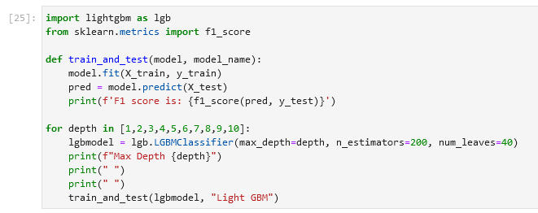
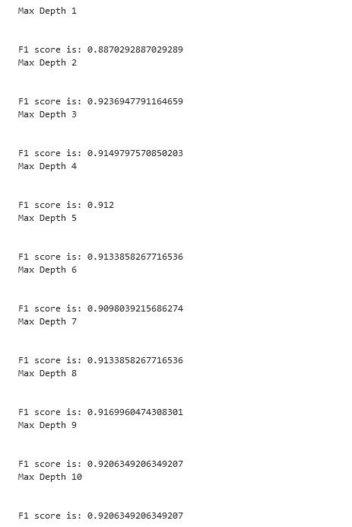
Model Building
We will be utilizing a machine learning algorithm known as LightGBM:
15
Notes:
The performance metric for this project is the F1 score. This metric considers both precision and recall to compute the score. The F1 score reaches its best value at 1 and worst value at 0.

Slide 16
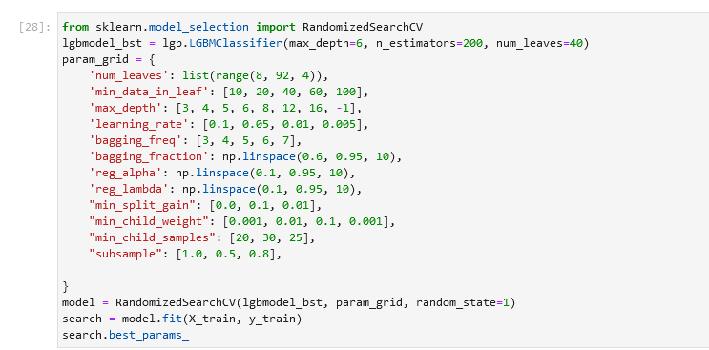

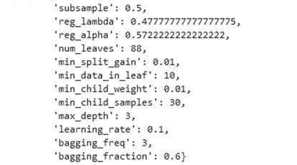
Model Building
16
Notes:
The performance metric for this project is the F1 score. This metric considers both precision and recall to compute the score. The F1 score reaches its best value at 1 and worst value at 0.
We will further perform a random grid search for the best parameters for the model:
Let's check the performance of the model by its prediction:
As a last step, we'll do a full training on the dataset so our web app can make predictions for data it hasn't seen. We'll save the model to our local machine:

Slide 17

04
the spam detection Application
17
Notes:
Now that we have the trained model, we are going to create a Flask application that will read messages sent and receive and classify them into spam or ham. The final result will be displayed in an SMS dashboard

Slide 18
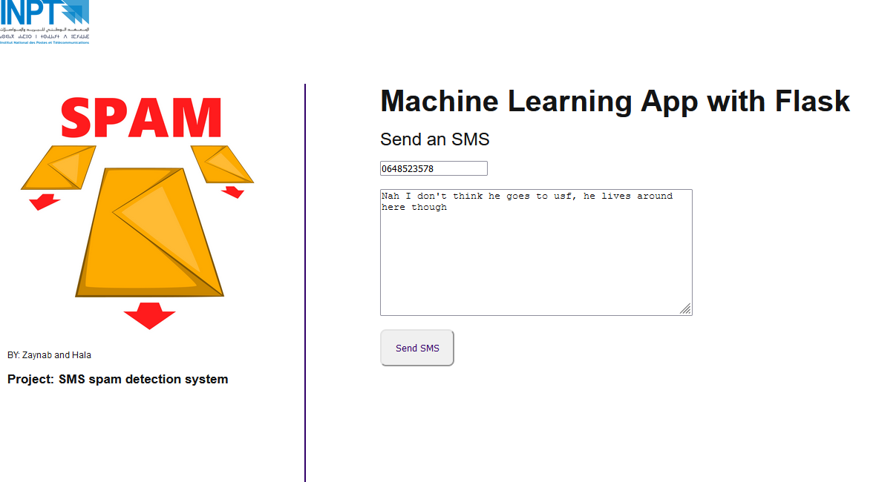
Home page
18

Slide 19
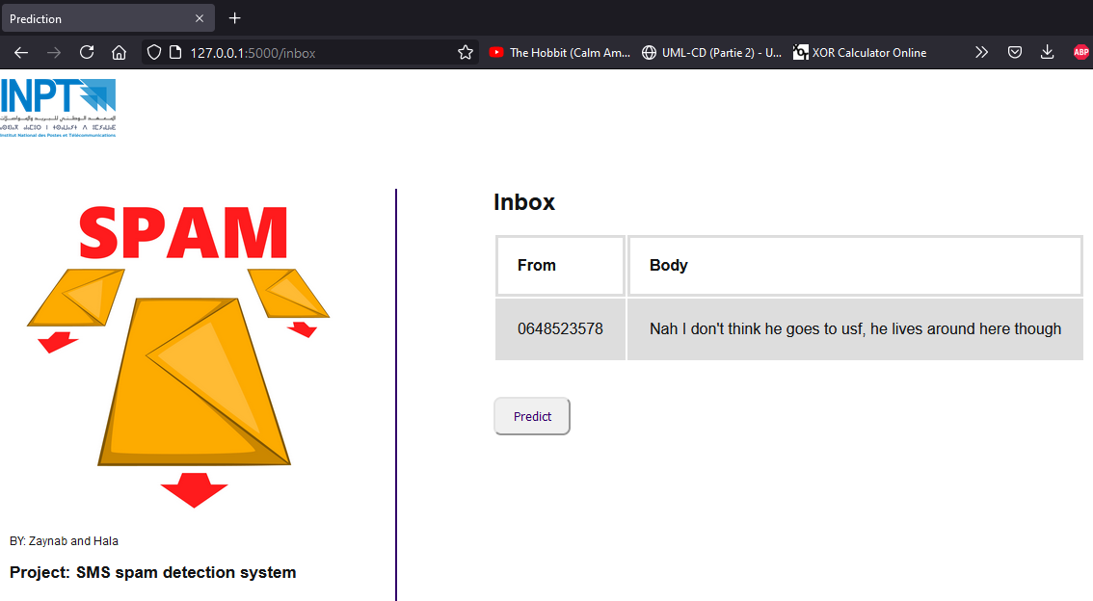
Inbox page
19

Slide 20
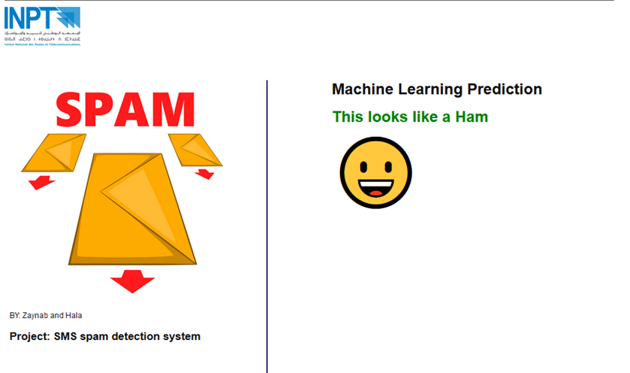
Prediction page
20

Slide 21
Thank you !

